Slide 1



darrius Lee
PORTFOLIO

Slide 2
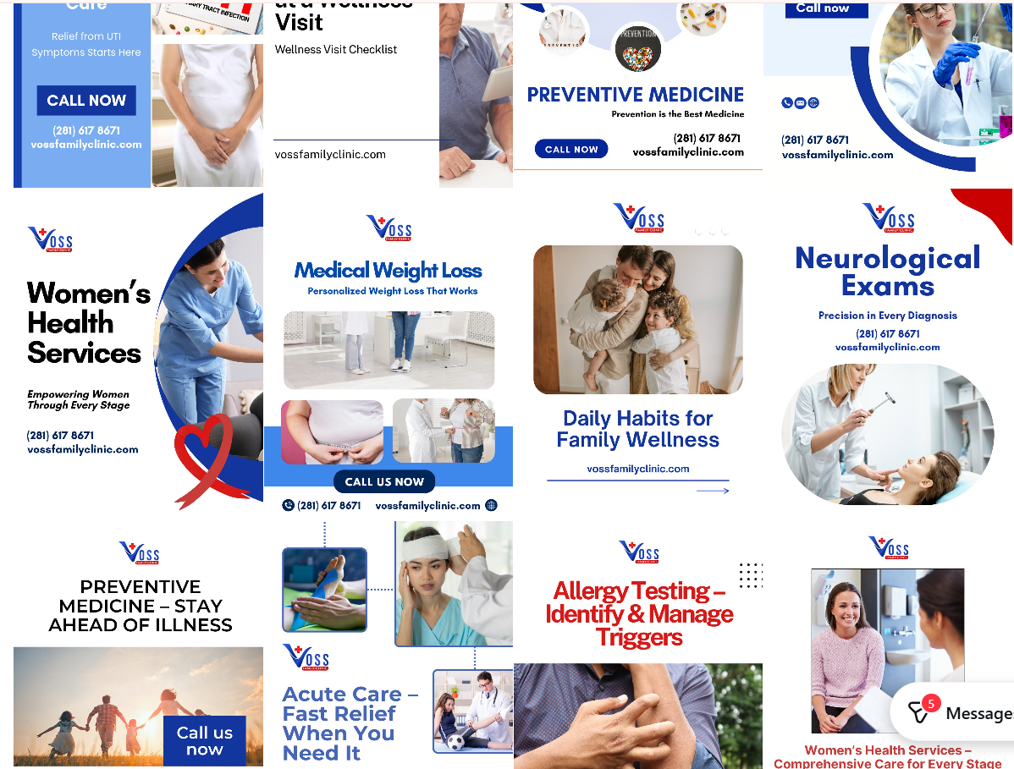
VOss family Clinic
Aug 2024- April 2025
About: Voss Family Clinic is a local family doctor’s office in HTX Sugar Land where you can go for regular physicals, chronic health support, urgent care, and things like allergy or weight-loss programs. Their team focuses on helping people stay well with personalized care and practical solutions
  My Role: Marketing & Community Outreach Coordinator. Managed social media and content creation for clinic marketing initiatives. Conducted in-person outreach at hospitals, events, and conferences to promote clinic services and increase patient engagement. Communicated brand mission and care offerings to healthcare professionals and community audiences.
Target: healthcare professionals, physicians, nurses, and hospital staff patients, families, and community members

Slide 3
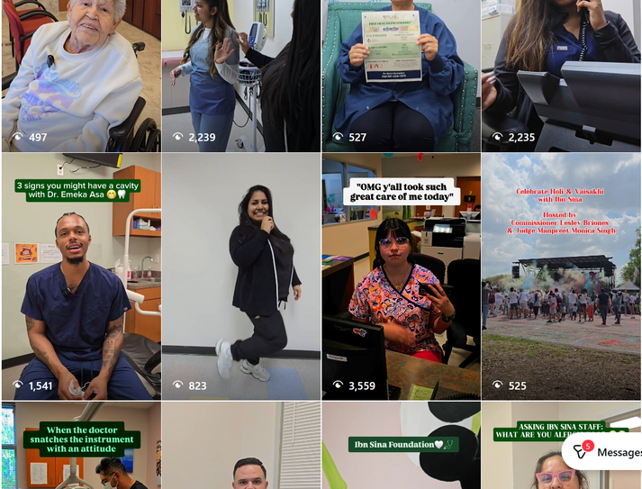


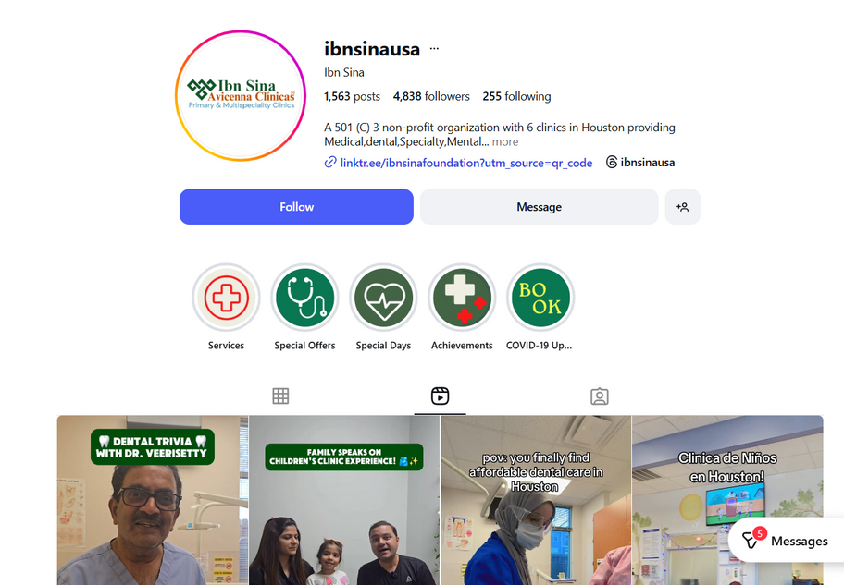
ibn sina
About : Ibn Sina Foundation is a nonprofit community health organization that provides affordable medical, dental, and mental health care to underserved families in the Houston area.
My Role: Marketing & Community Outreach Coordinator. Managed social media and content creation for clinic marketing initiatives. Conducted in-person outreach at hospitals, events, and conferences to promote clinic services and increase patient engagement. Communicated brand mission and care offerings to healthcare professionals and community audiences
April 2025 - Aug 2025

Slide 4
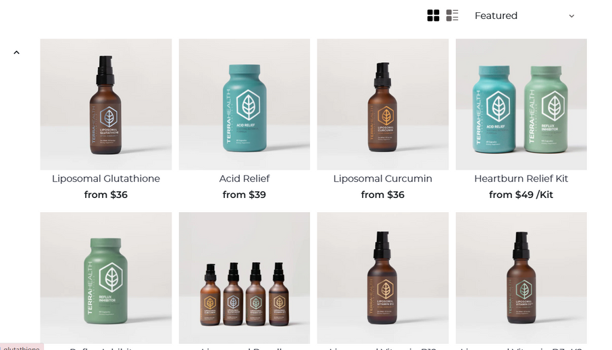
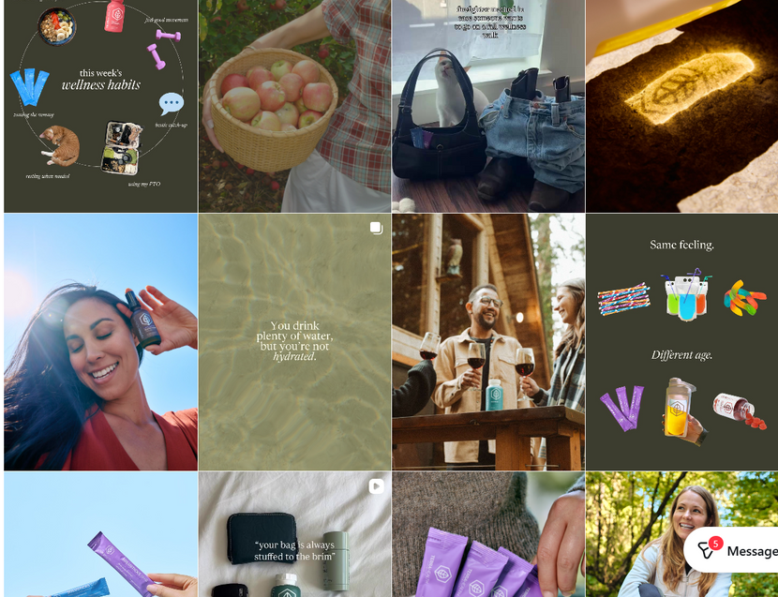
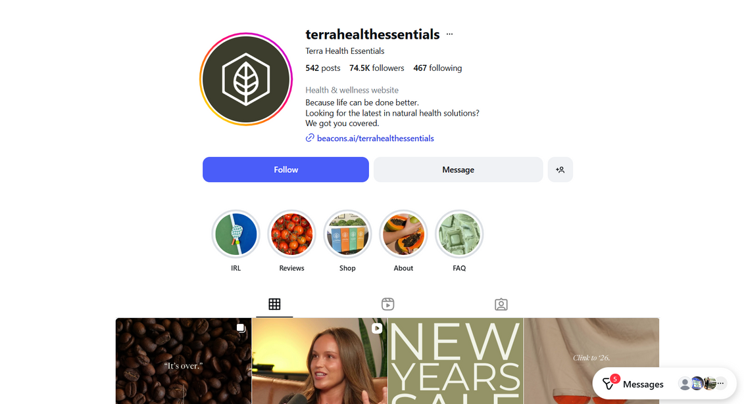
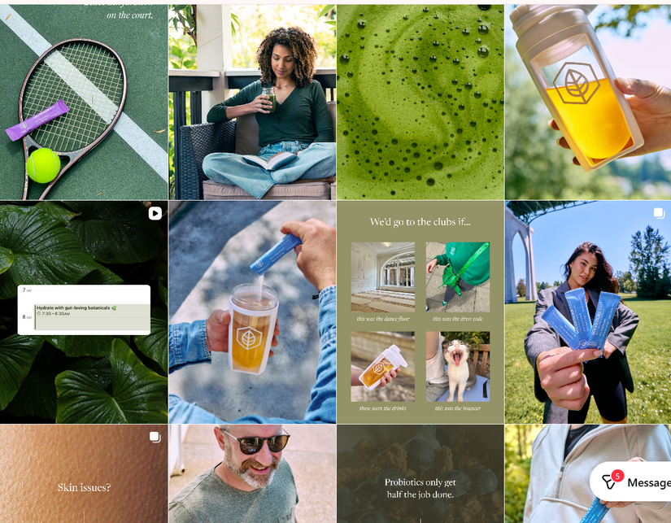
terra Health
About -Terra Health is all about natural wellness, especially gut health. It started from personal experience and now focuses on creating products that mix natural ingredients with science to help people feel better day to day.
  My Role : Marketing Assistant - Supported customer orders and inquiries for dietary supplements and prescription medications via outbound calls and email. Managed social media, content creation, and website updates. coordinated a small team to support project execution.
aug 2025--dec 2025

Slide 5
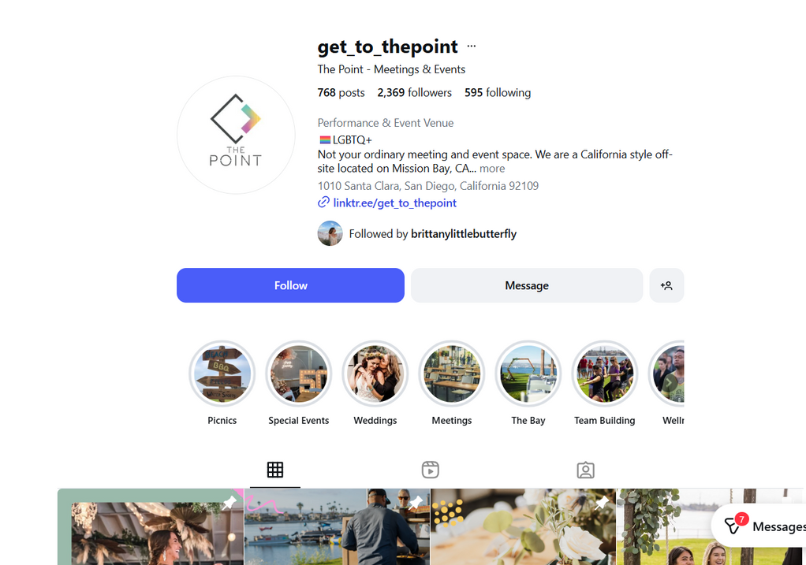
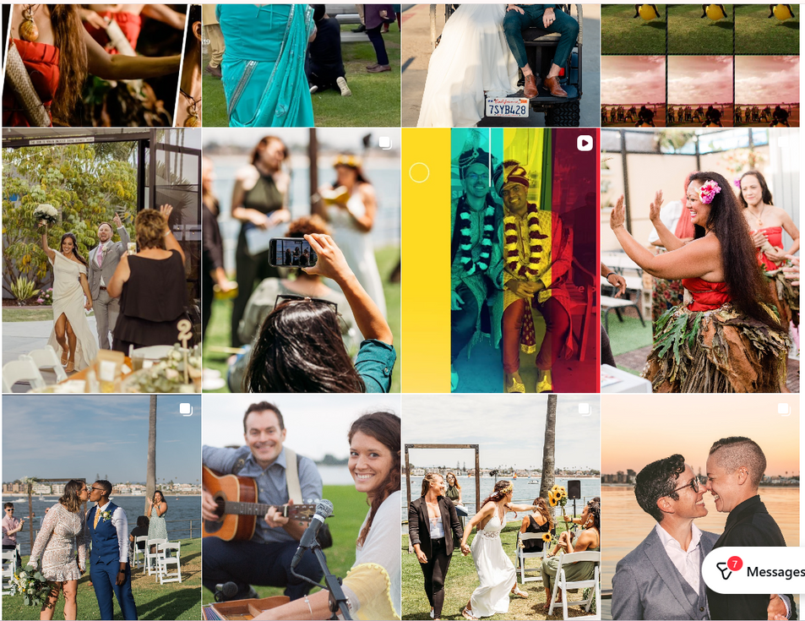
The Point
About: The Point is this really cool event venue right on Mission Bay in San Diego. It’s perfect for everything from weddings and corporate meetups to special celebrations — and it has a laid-back California vibe with eco-friendly touches and beautiful ocean views.
My Role: Social Media & Event Operations Lead Managed social media, website updates, and event content creation. Coordinated on-site and remote event operations, leading a team that handled orders and support when off-site. Ensured smooth execution through staff and vendor coordination.
Oct 2023-May 2025

Slide 6
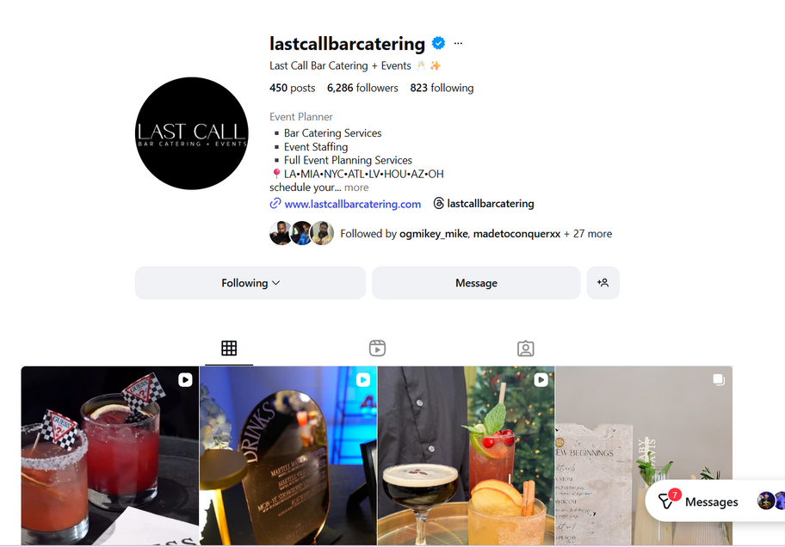
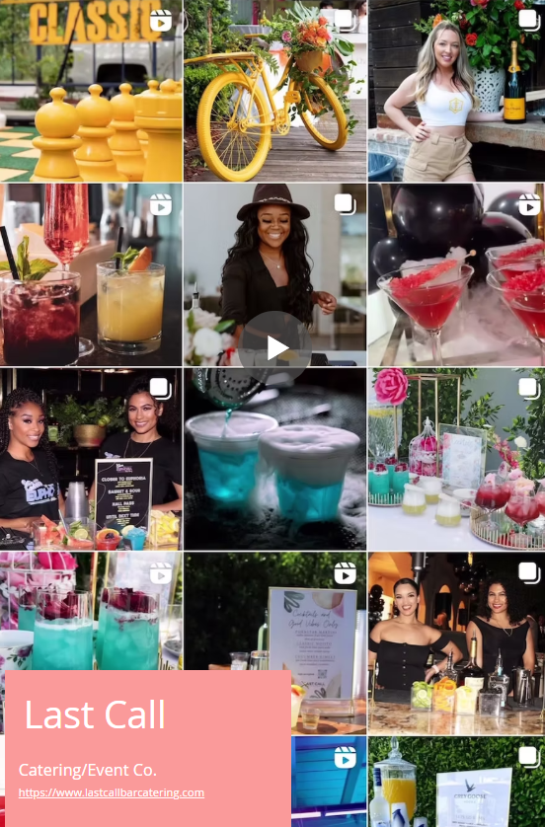
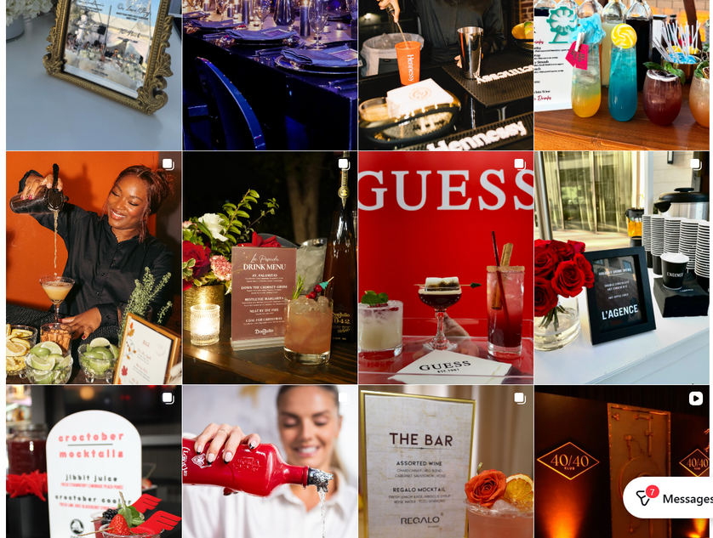
Last Call
bar + Catering
About: Last Call Bar Catering + Events is a nationwide bar catering and event planning company that makes celebrations pop with crafted cocktails, premium spirits, and full-service coordination. Think custom drink menus and smooth execution — so every event feels special
  My Role: Managed social media, website updates, and event content creation. Assisted with event operations both alongside the owner and independently, coordinating staff and vendors as needed
Jan 2021- Current

Slide 7
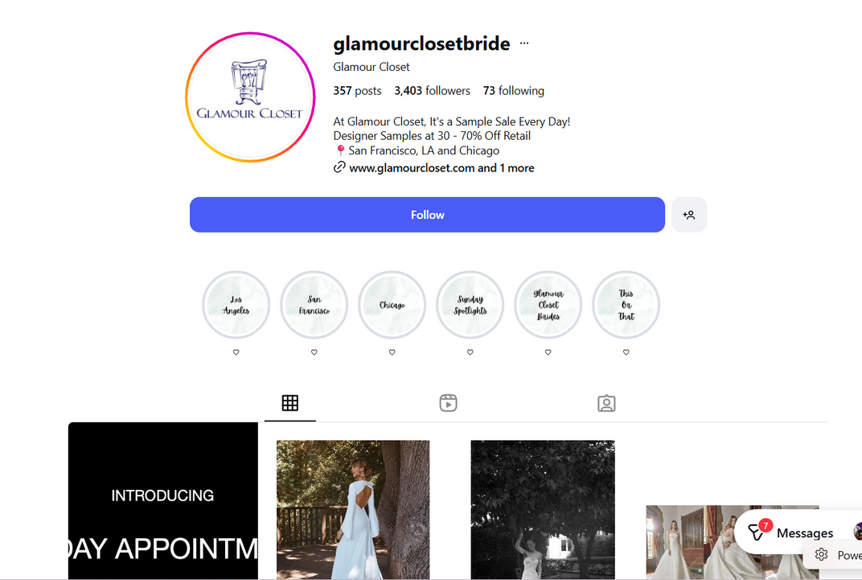
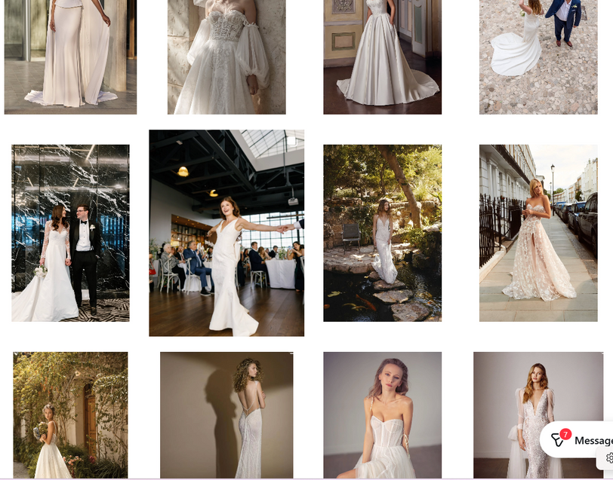
Glamour Closet
My Role: Manager - Sold designer dresses, consistently hitting sales goals and earning promotion to Store Manager. Managed schedules, inventory, opening/closing procedures, and store operations. Attended trunk shows, fashion shows, and events representing the brand.
Glamour Closet is a stylish women’s fashion shop where you can find trendy designer pieces and unique wardrobe staples that make outfits feel special — kind of like your go-to spot for elevated, chic looks.
June 2018 to Dec 2020

Slide 8
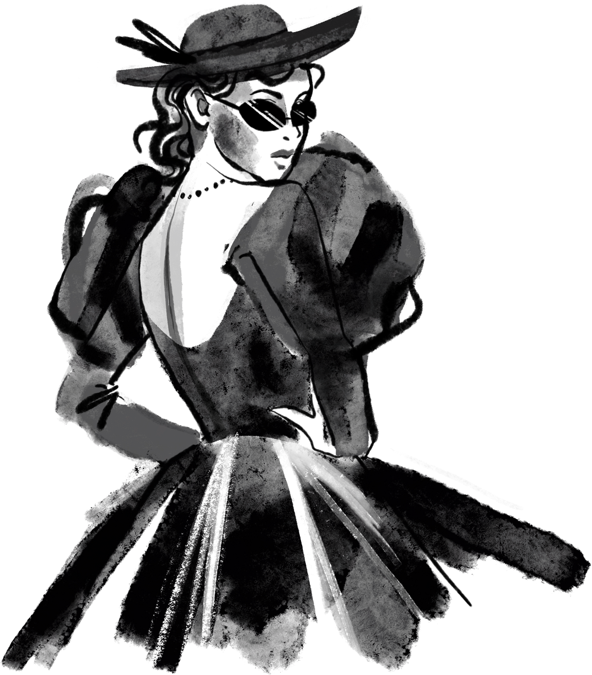
Thank you,
I’m excited about the possibility of bringing my experience, creativity, and leadership to your team.
DARRIUS
Lee

